Slide 1









Insurance Policy Portfolio Analysis and Reporting Tool
PRESENTATION 2026
Student Name
Student Email
Sonam Singh
Shifa Bano
Pranjali Chawan
Molishka Rokade
sonamsushilsingh2372005@gmail.com
shifakhannnn835@gmail.com
pranjalichawan53@gmail.com
rokademolishka@gmail.com
Guide
Hrishikesh Mahure

Slide 2

OUTLINE
Abstract of the Project
Problem Statement
Proposed Solution
System Architecture
Live Demo of the Project
Project Demo Screenshots
Conclusion
Future Scope

Slide 3

Abstract
This project develops a centralized analytical platform to transform fragmented insurance data into actionable intelligence. By automating risk assessment and KPI reporting, the tool enables insurers to identify loss patterns, ensure regulatory compliance, and transition from reactive management to data-driven strategy. It ultimately optimizes portfolio stability and drives long-term profitability through real-time, predictive insights.

Slide 4



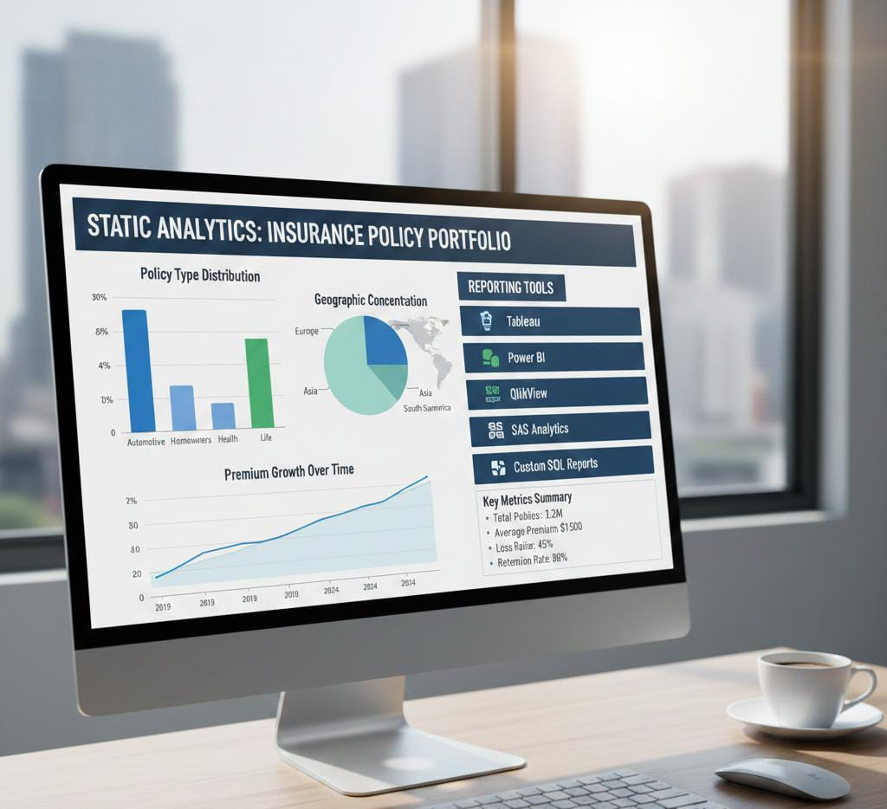

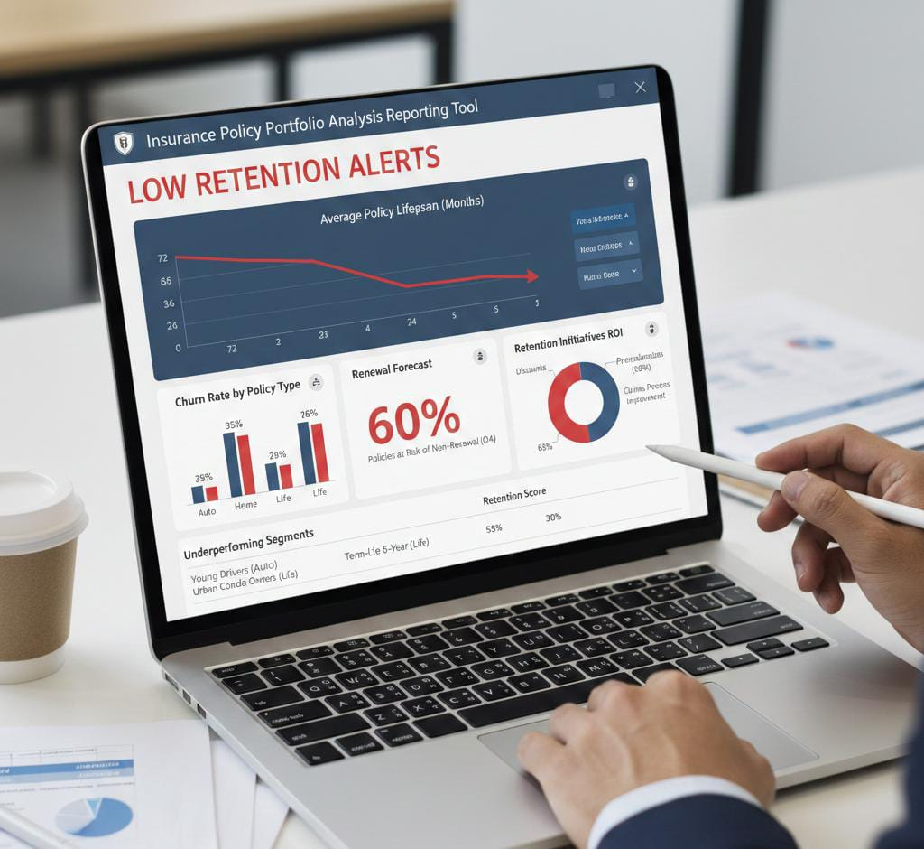
Problem Statement

Slide 5

Proposed Solution
Centralized Repository
Real-Time Analytics Dashboard
Automated Reporting & Alerts
What-If Scenario Analysis
Performance Tracking

Slide 6




System Architecture

Slide 7
Live Demo of Project

Slide 8
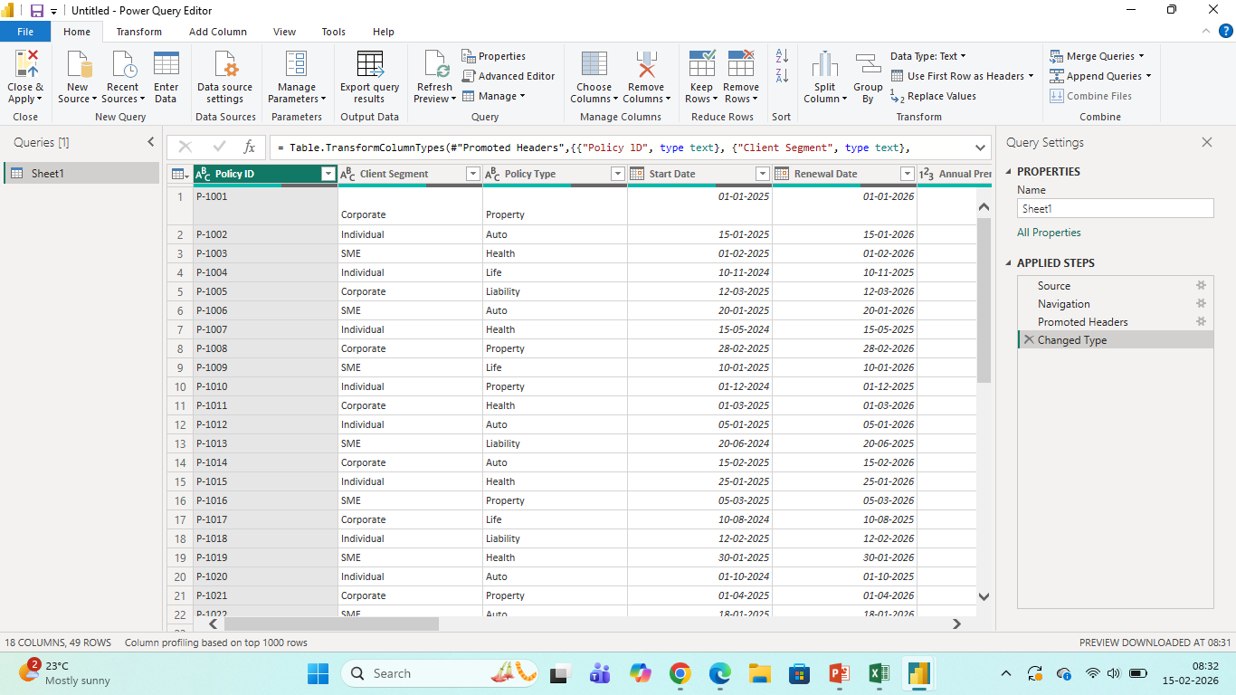
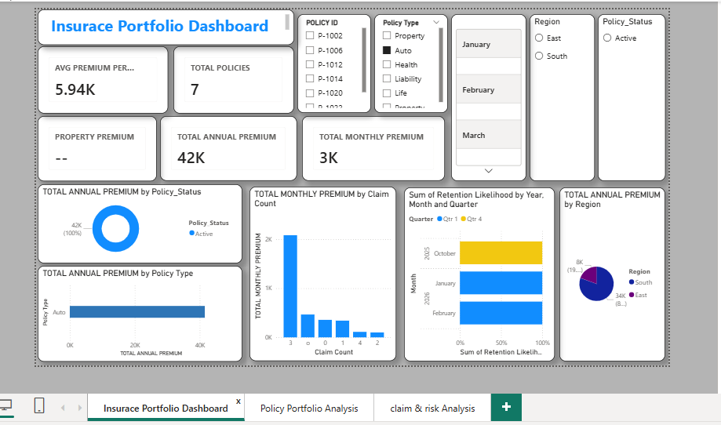
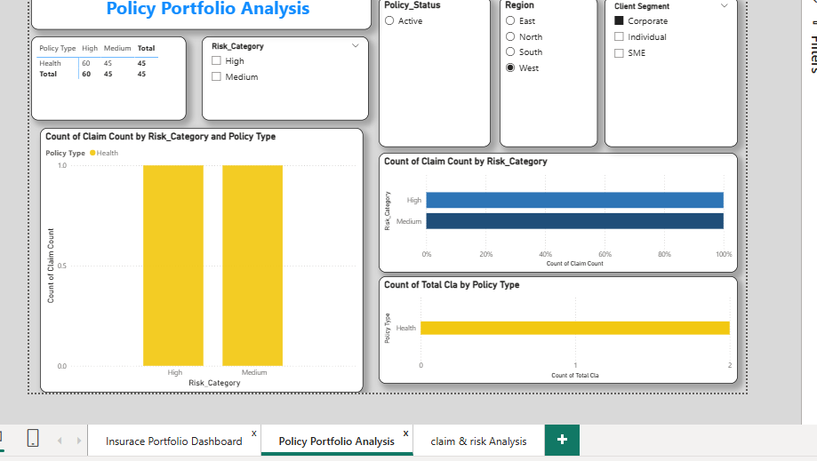
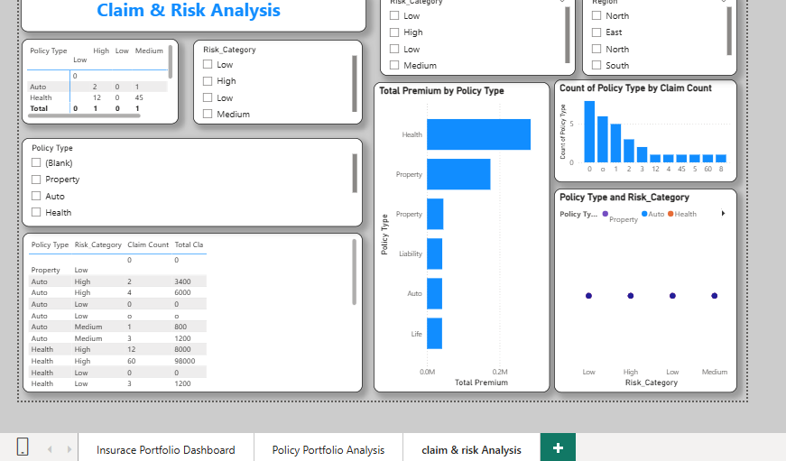
Project Demo Screenshots

Slide 9

Conclusion
In conclusion, This Power BI provides clear insights into insurance portfolio performance and the financial factors influencing it. The analysis helps insurance providers identify areas of financial leakage and implement effective risk management and renewal strategies.

Slide 10

Future Scope
Predictive Analytics
Automated Risk Scoring
Mobile Integration
Fraud detection

Slide 11
Reference:
https://extsla.co.in/
https://share.google/t1aKCvSw0Lh4BR8dG
https://link.springer.com/book/10.1007/978-1-4614-4103-8
https://share.google/gOslT4utzOcYKtlaQ
https://enterprisedna.co/showcase/insurance-portfolio-analysis?hl=en-US

Slide 12
Thank You
Notes:
thank you very much for joining this PPT, keep learning.
12

